Slide 1

Deloitte USI AI Academy
Capstone Project
Store Sales
Sai Teja Burla
Vishnu S
Spandana Y R
Yashwanth K
Thathireddy Vishnuvardhan Reddy
Tilak Raj
Batch: B
Group: 5
Date: 24/03/2022
Members:

Slide 2

01
Problem Statement
02
Data Analysis
03
Visualization
04
Data Pre-Processing
05
ML Model Development and Evaluation
06
PySpark and AWS
07
Model Deployment and Demonstration

Slide 3
Store Sales Forecast
Problem Statement
Dean’s is a large web e-trailer chain which sells different types of products nationally. It has shopping services via different modes/types of transportation. It keeps track of order details, shipping details, discounts, provided to the customer, profit earned etc.
Solution
To preprocess and aggregate the data into monthly sales
To identify various factors in the data such as trend, seasonality and stationarity, etc
To build various forecasting models for the time series data for forecasting sales in future
Comparing all the forecasting models based on RMSE value to find the best one

Slide 4
IMPLEMENTATION
DATASET
SQL
DATA ANALYSIS
STATISTICS
PYTHON
DATA VISUALIZATION
POWER BI
DATA PRE-PROCESSING
MODEL DEVELOPMENT AND EVALUATION
ETL AND DATA ENGINEERING USING PYSPARK
AWS CLOUD ANALYSIS
MODEL DEPLOYMENT USING FLASK

Slide 5
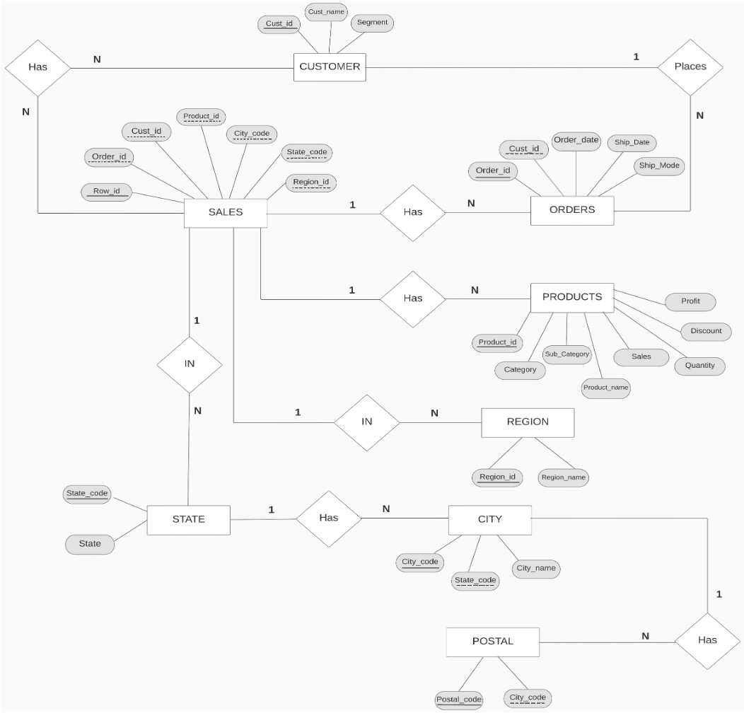
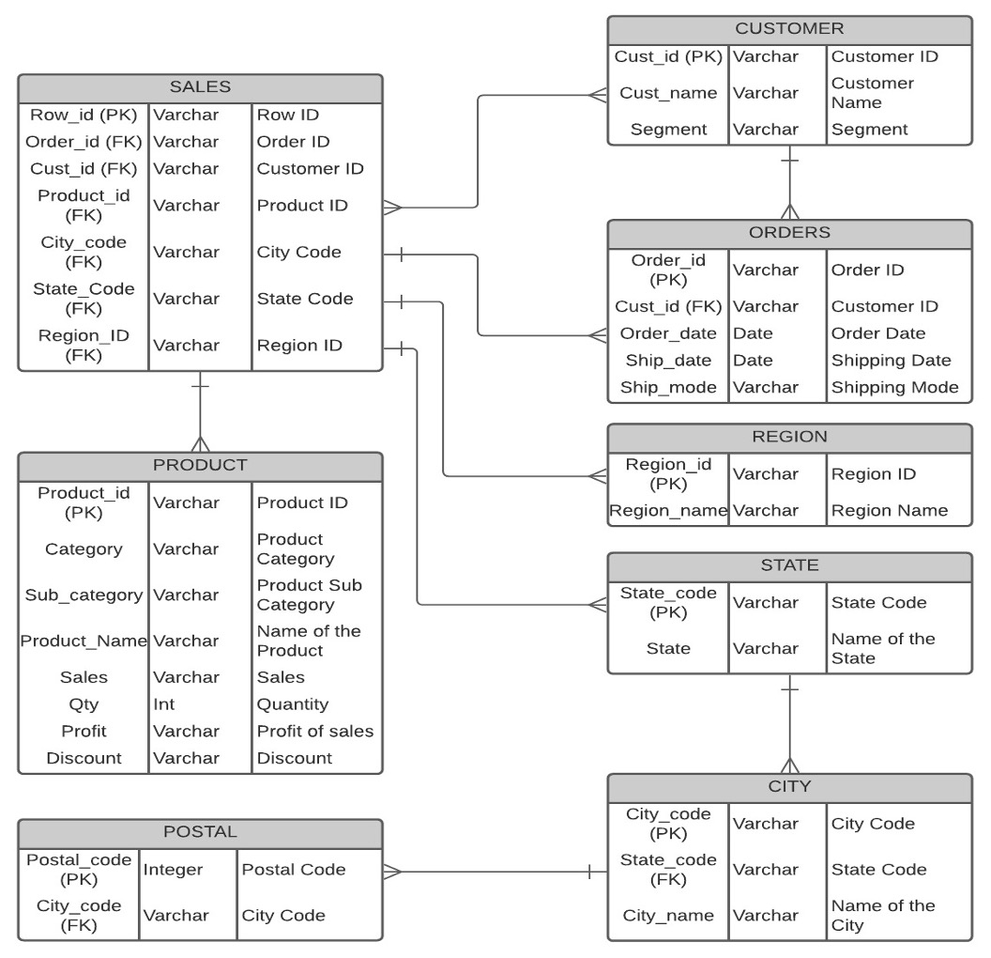
Data Analysis Using SQL
ER DIAGRAM
TABLE DESIGN

Slide 6
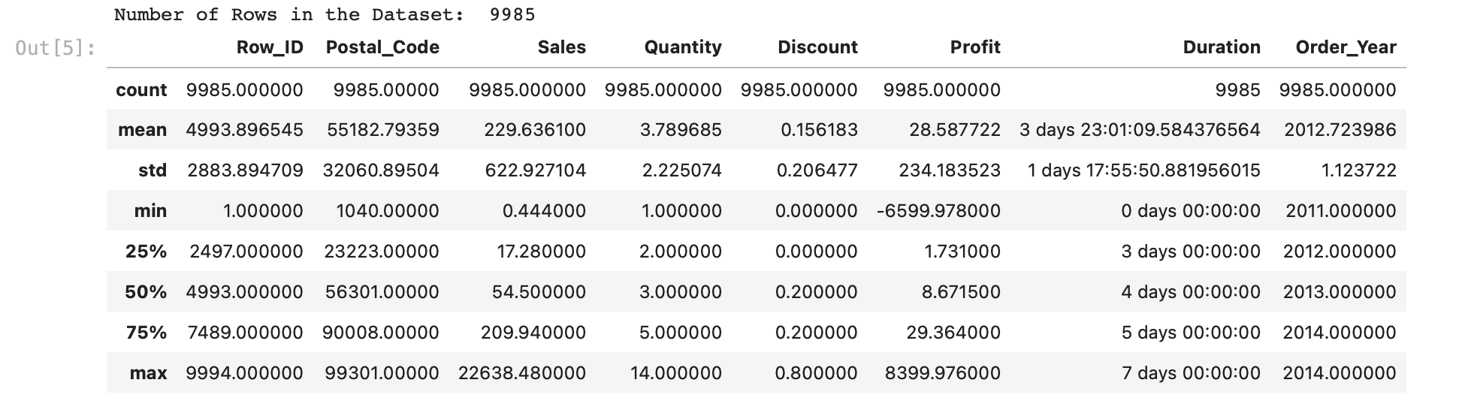
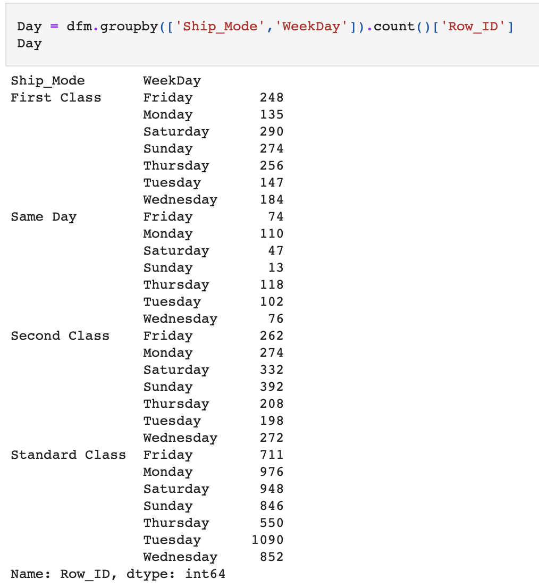
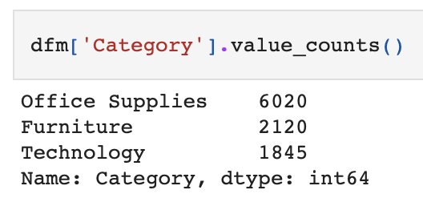
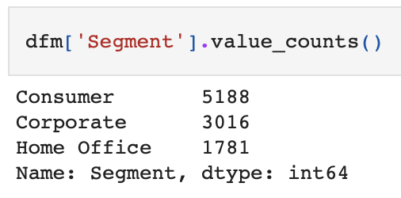
Data Analysis Using Python

Slide 7
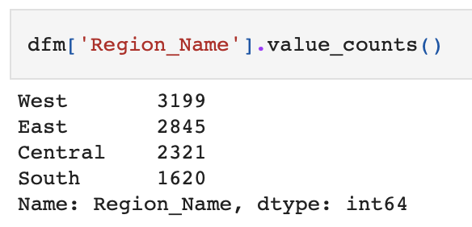
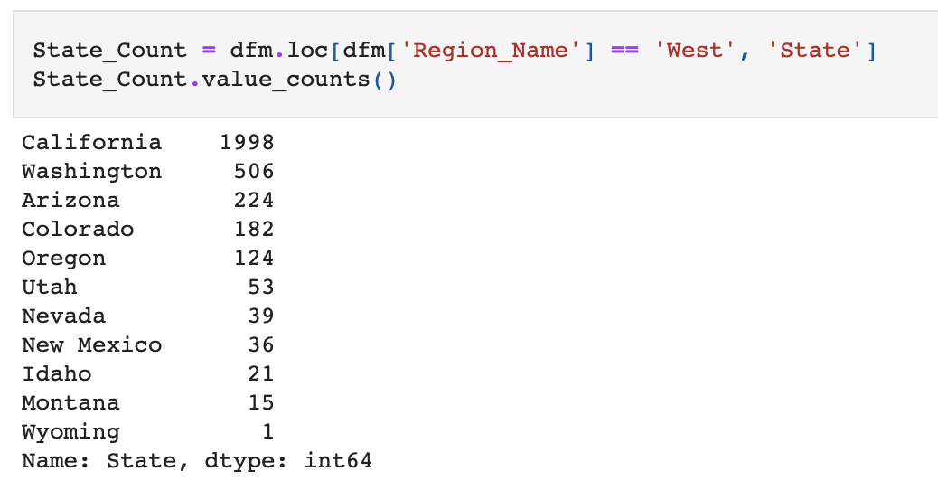
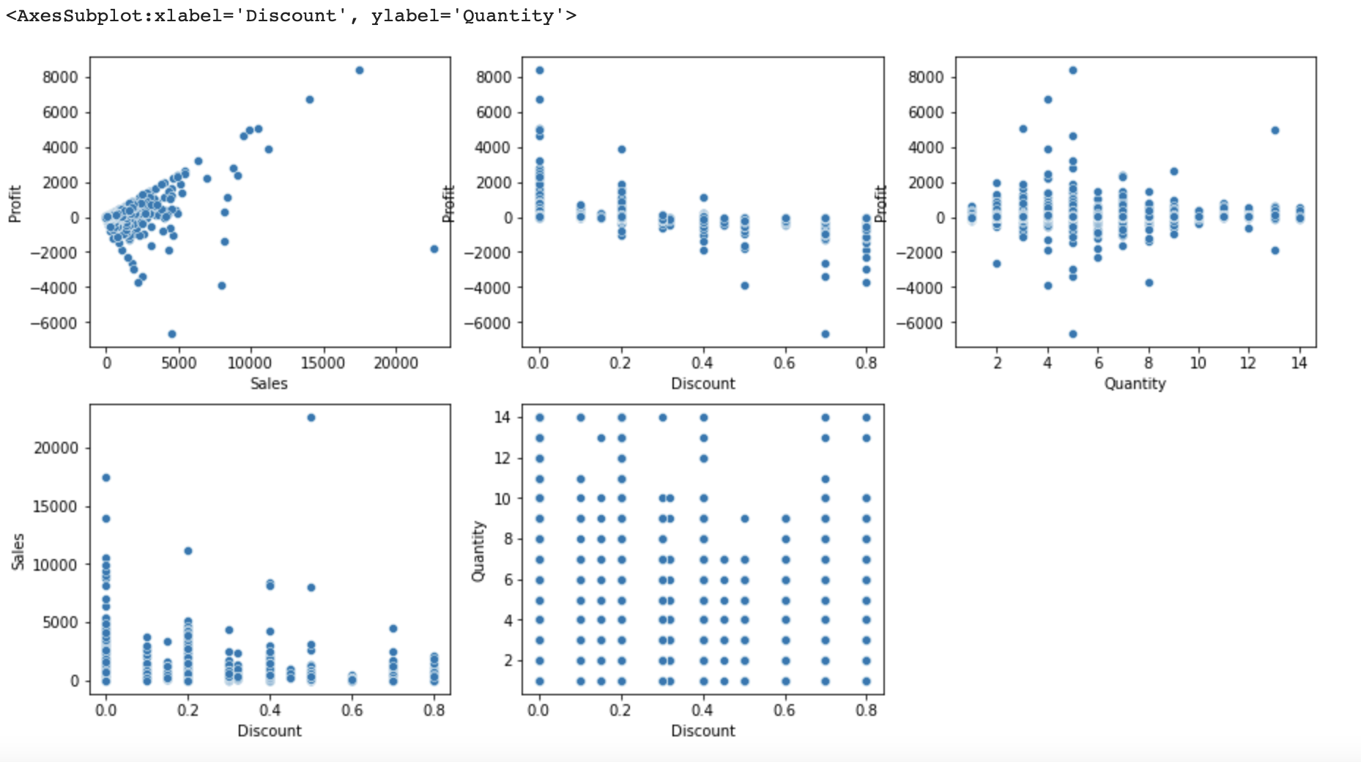
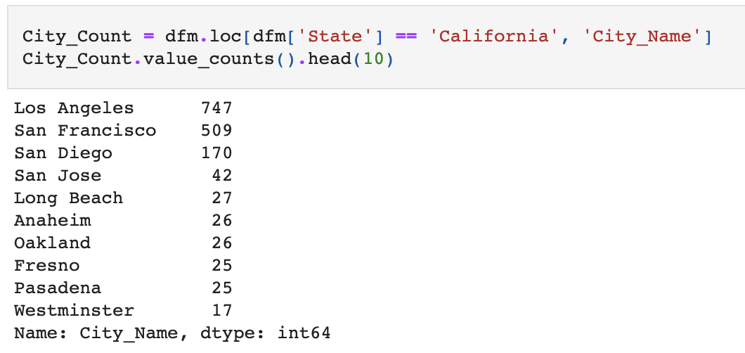
Data Analysis Using Python
Hypothesis Testing:
Anova
Chi-Square
T-Test(One Sample)
T-Test(Two Sample)
T-Test(Paired Sample)
Correlation Test

Slide 8
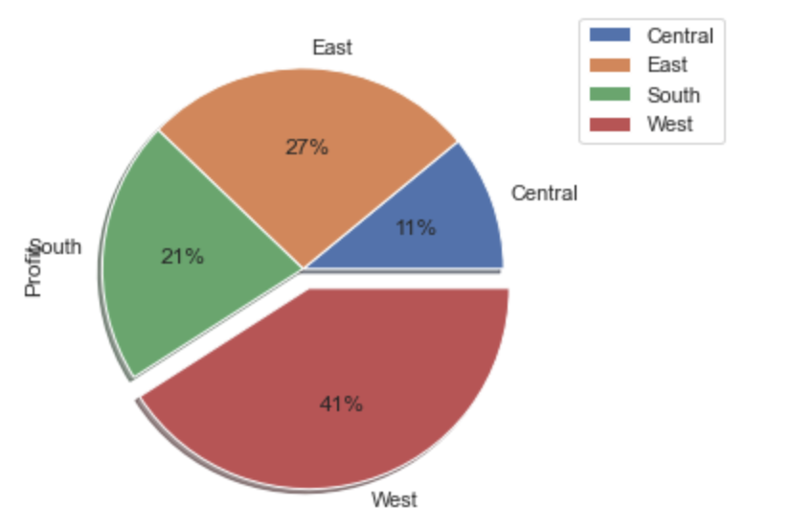
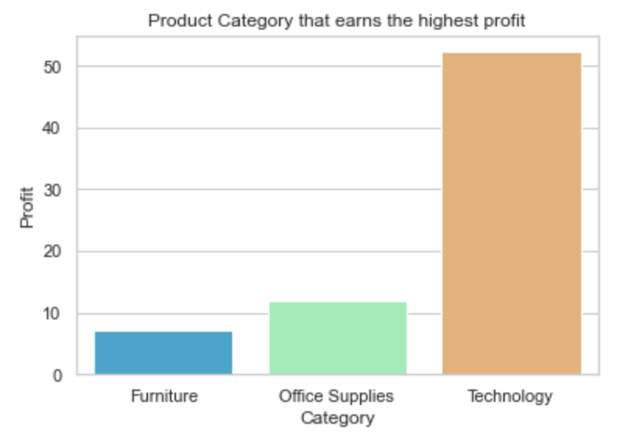
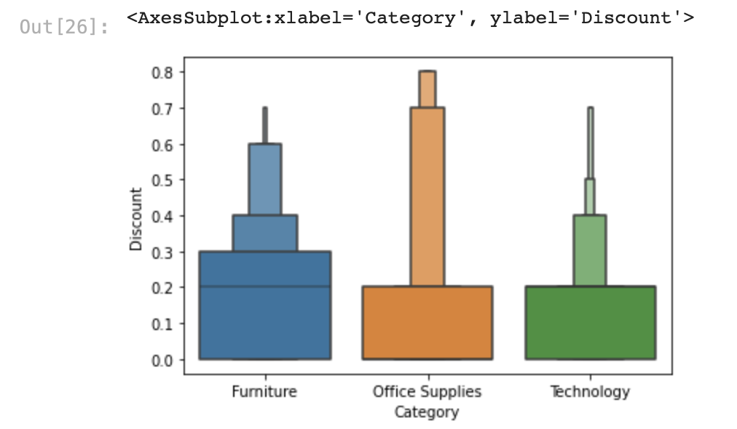
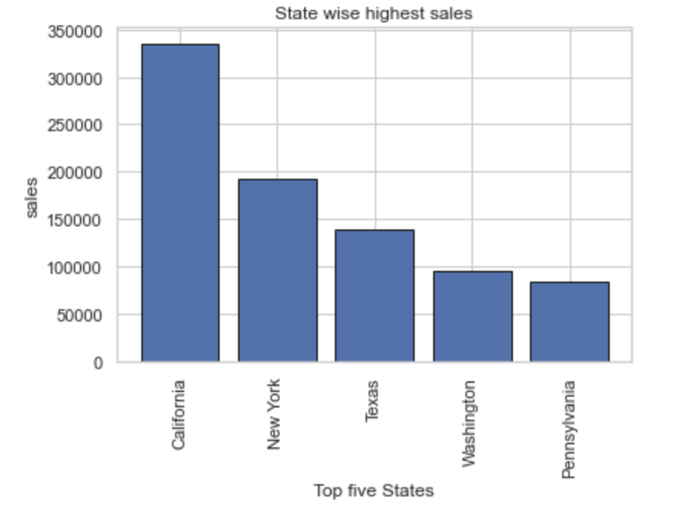
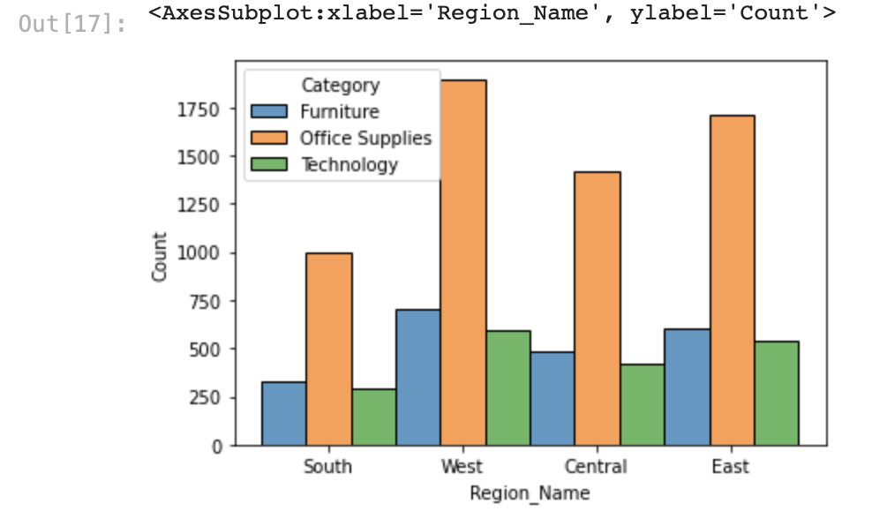
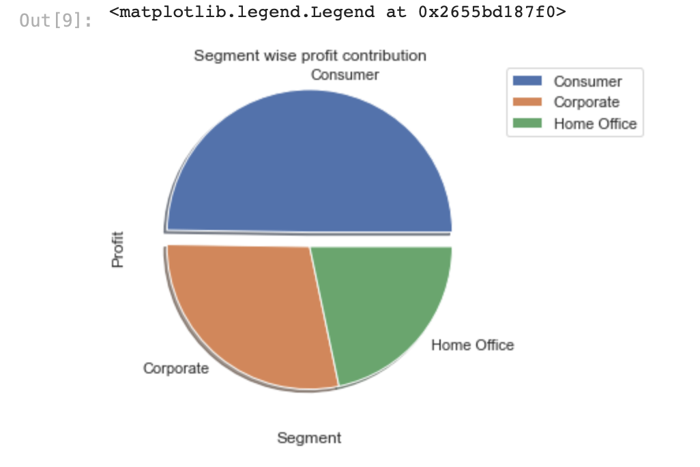
Data Visualization
Using Python

Slide 9
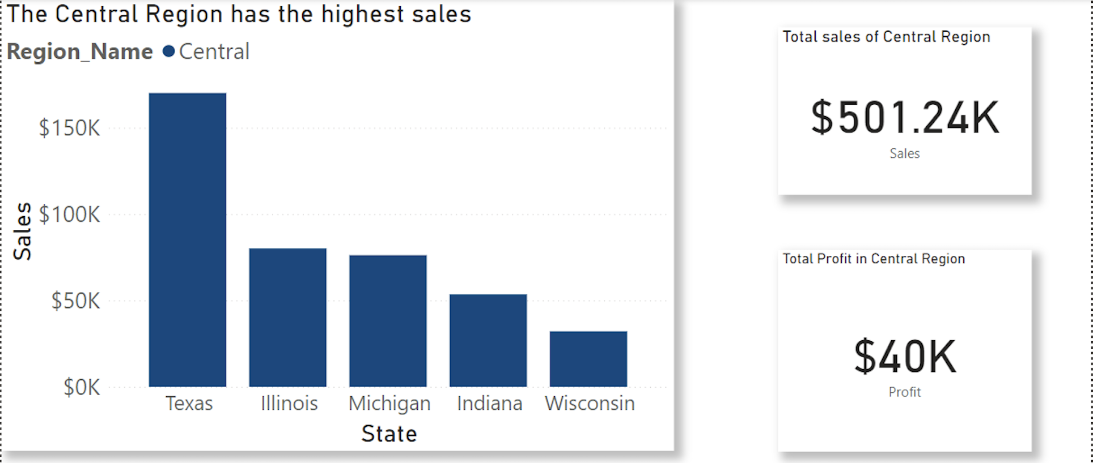
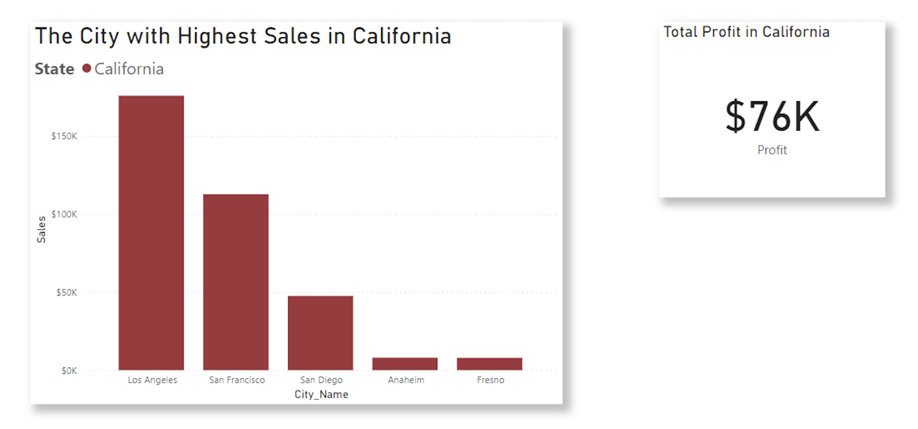
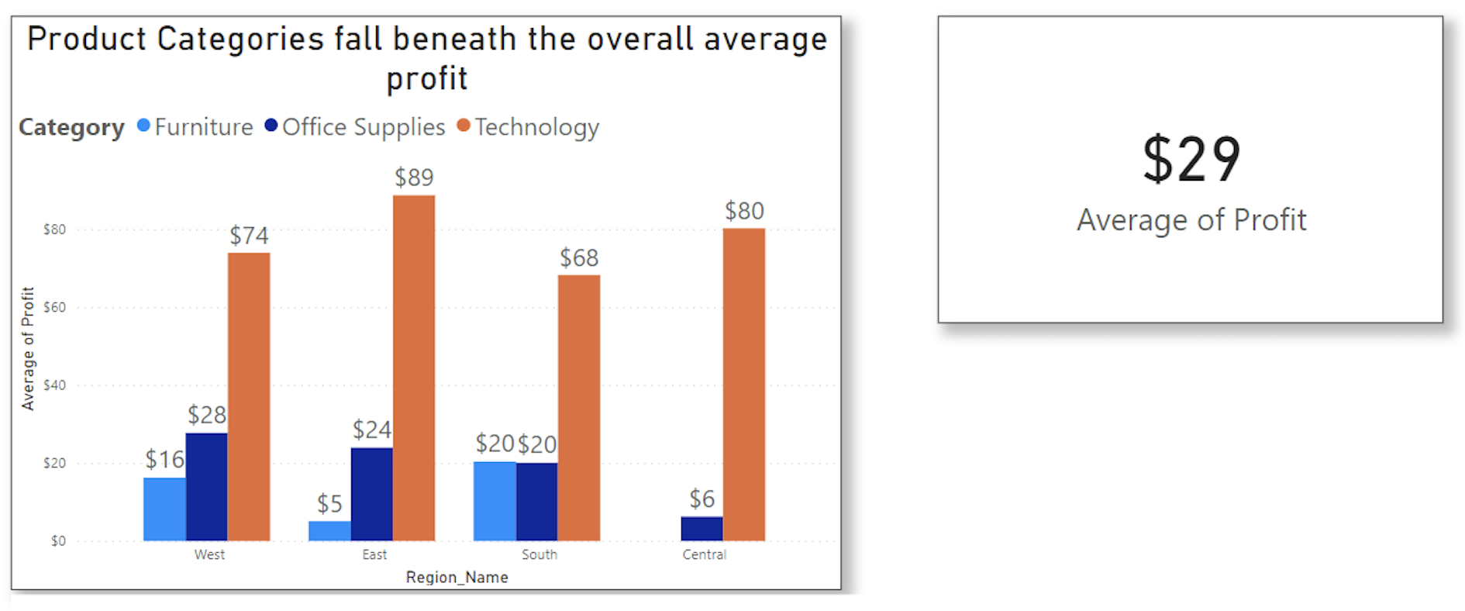
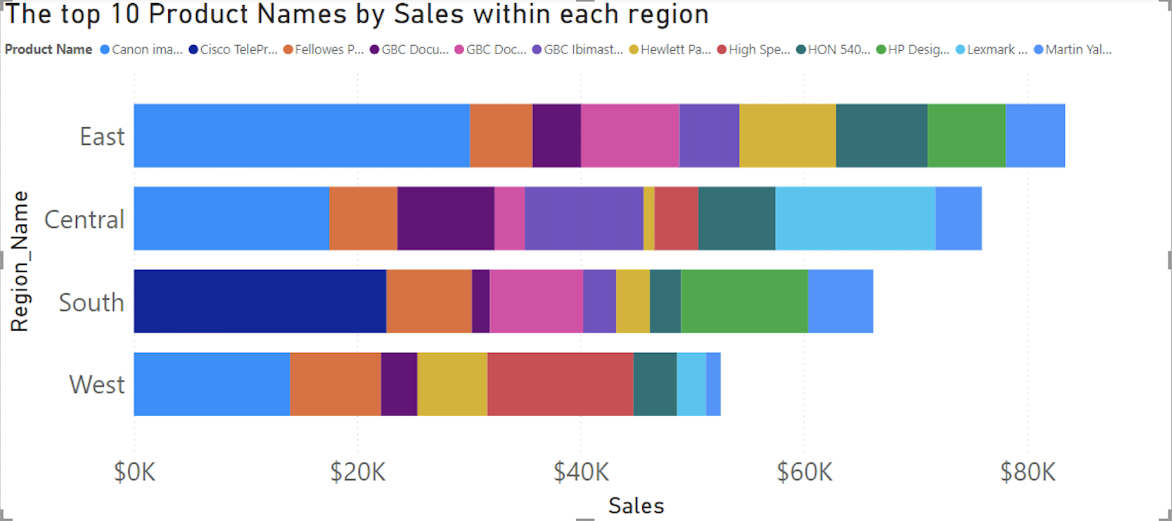
Data Visualization
Using PowerBI

Slide 10
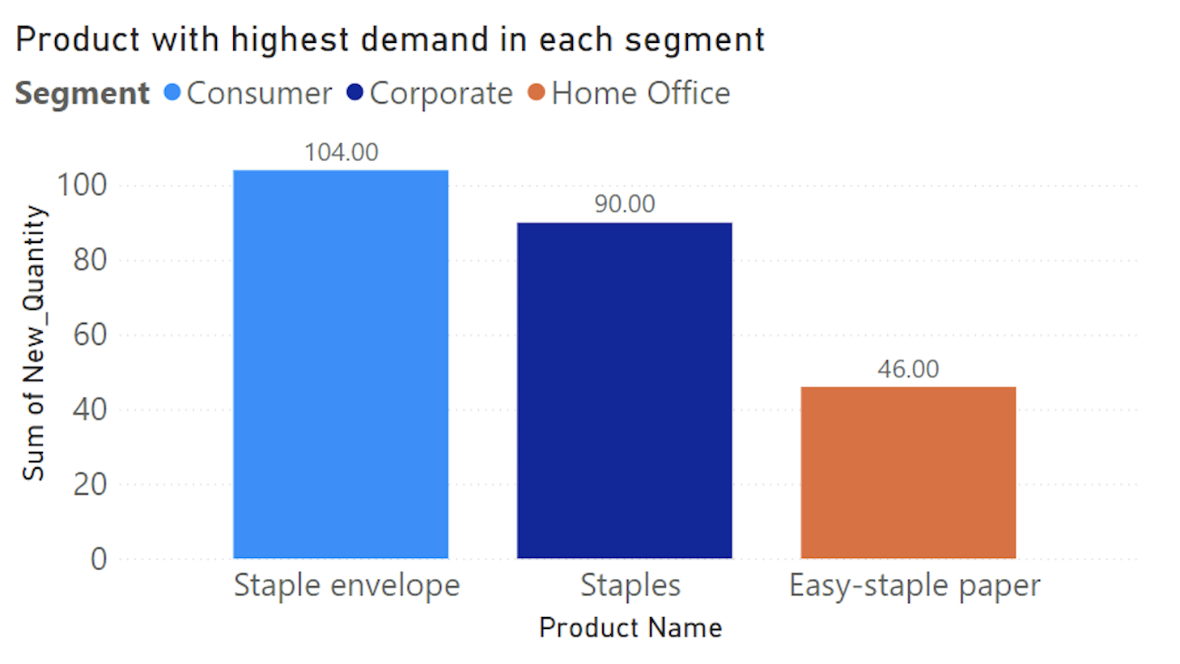
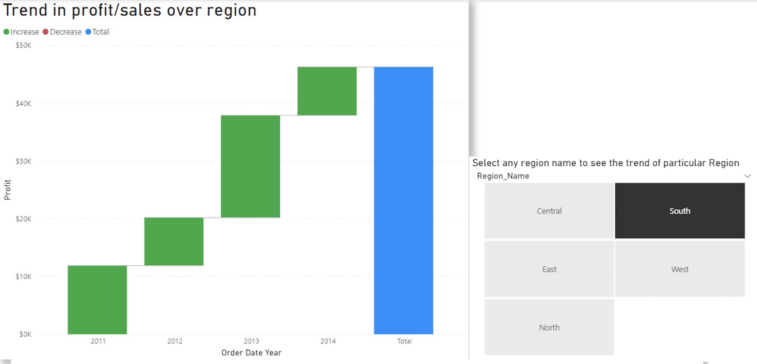
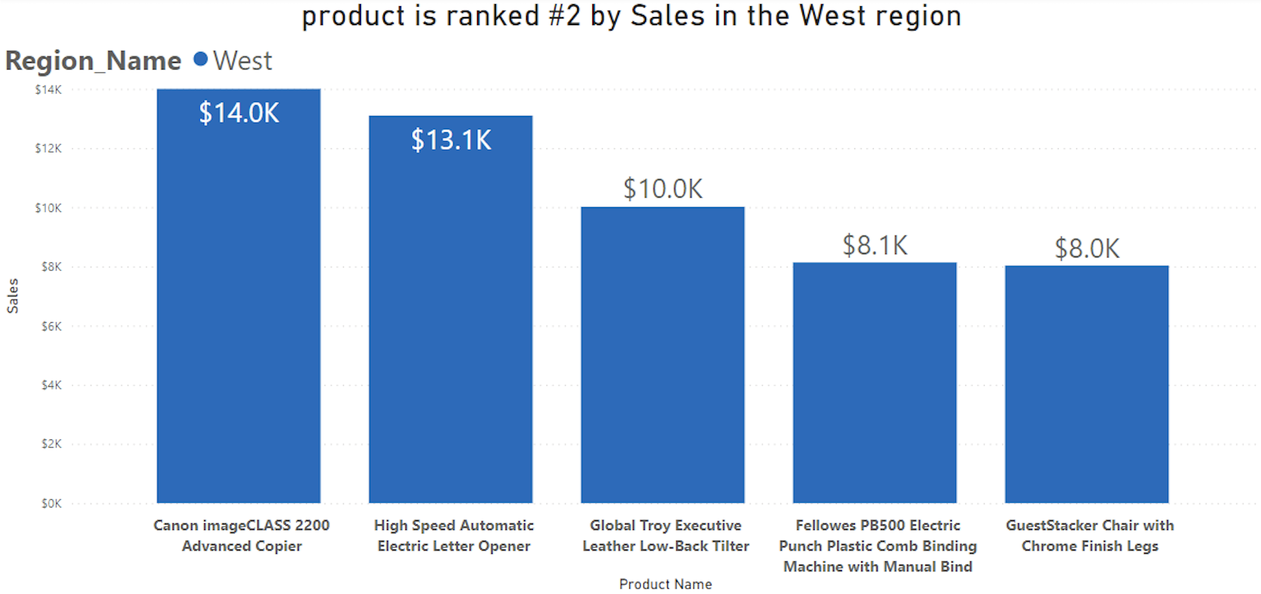
Data Visualization
Using PowerBI

Slide 11
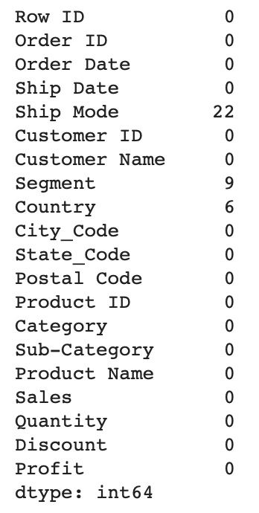
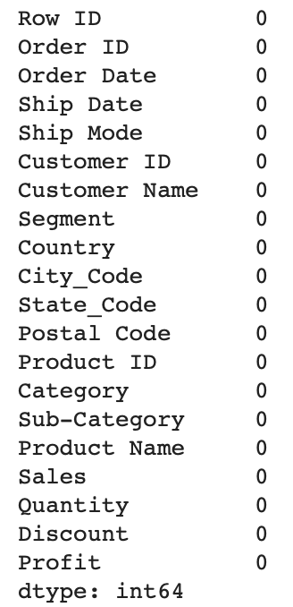
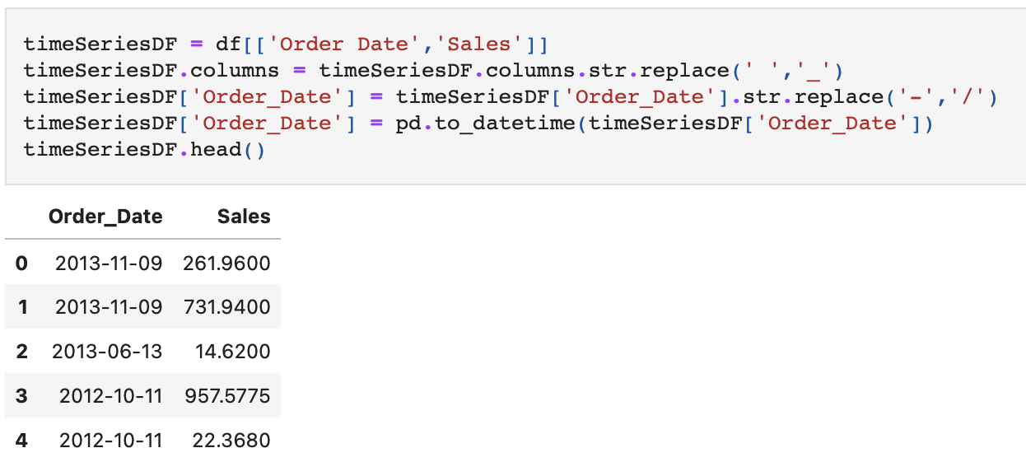
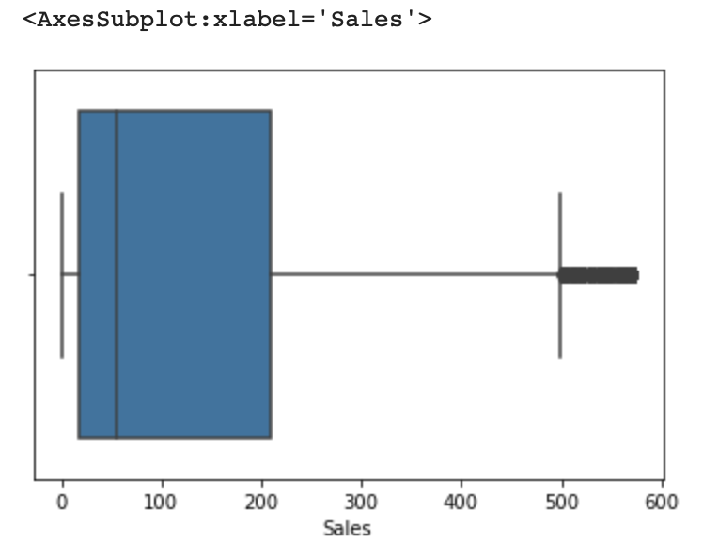
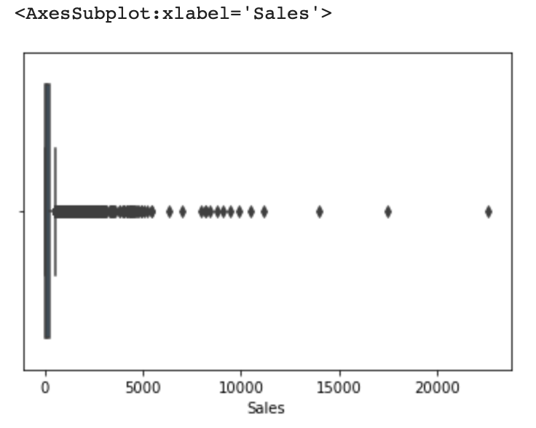
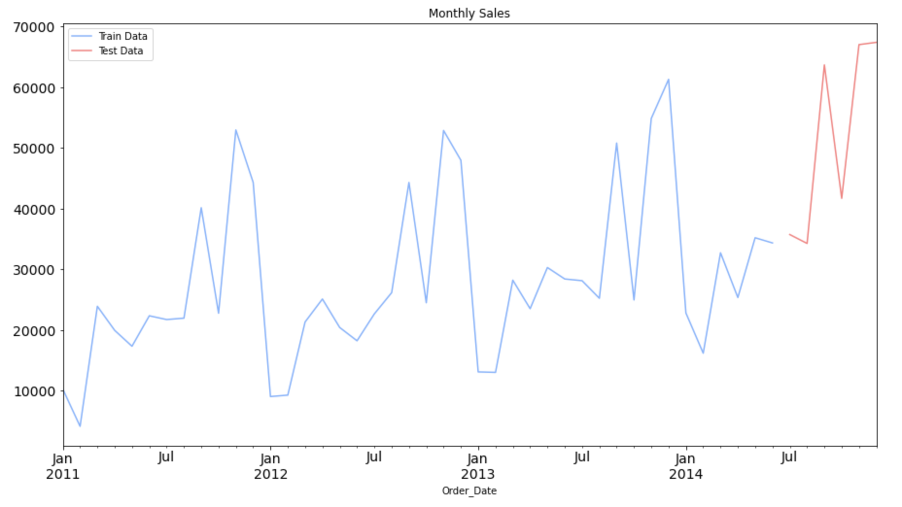
Data Preprocessing
Data pre-processing steps are normally used to convert the raw data into clean data set that can be used for training the model.
Null Value Detection and Treatment
Outlier Analysis and Treatment
Data Encoding
Data Scaling and Transformations
Feature Engineering
Splitting into Train and Test

Slide 12
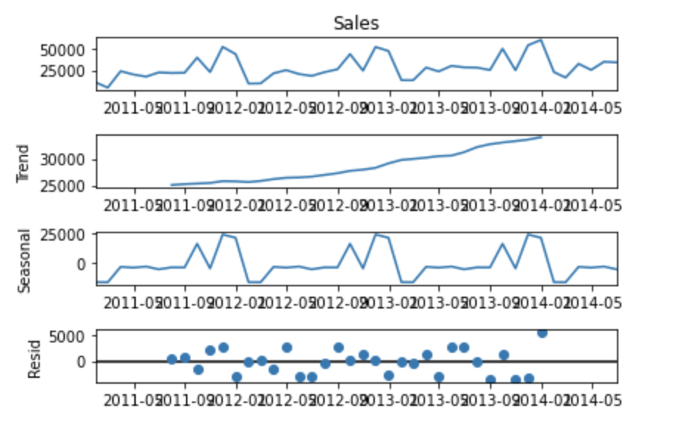
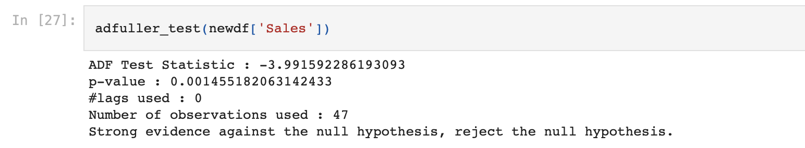
Stationarity, Trend
and Seasonality
We make use of Augmented Dickey- Fuller Test, a well known statistical test that can help determine if the time series is stationary. This is necessary as the models of time series require the data to be stationary.
Here our hypothesis would be:
H0: Data is not Stationary
H1: Data is Stationary
As we can see below the p-value is way less than 0.05(alpha) so we can reject the null hypothesis and say that our data is Stationary.
As we can see in the above graphs we have an up trend and we can also observe a seasonality in the data which could be used for our model building part.

Slide 13
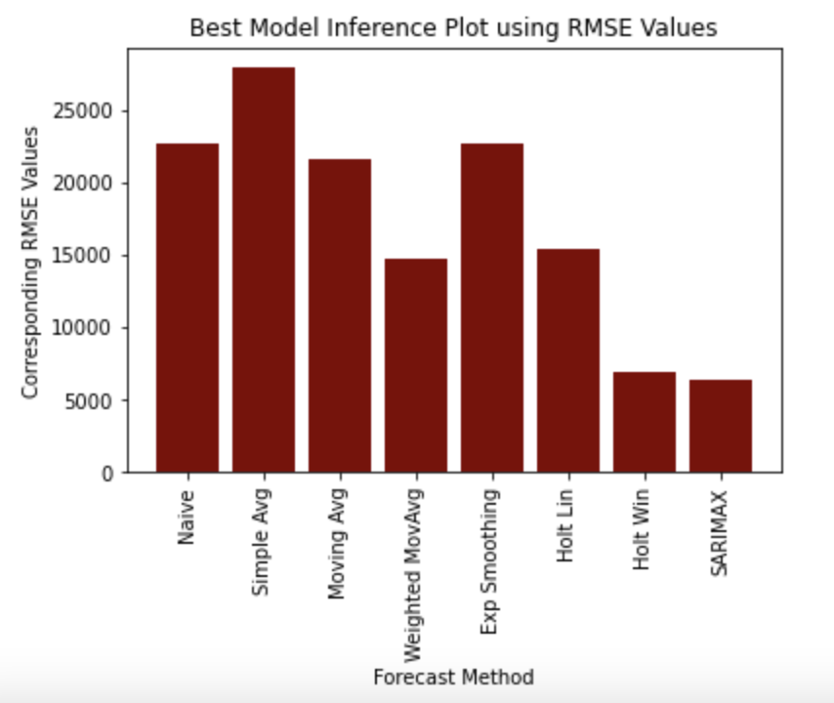
ML Models
Sr. No. | Model Name | HyperParameters | RMSE Values
1 | Naive Method | N.A. | 22652
2 | Simple Average | N.A. | 27881
3 | Moving Average | rolling = 10 | 21522
4 | Weighted Moving Average | rolling = 3 weights = 0.5,1.5,2.5 | 14681
5 | Exponential Smoothing | smoothing_level = 0.95 | 22637
6 | Holt Linear | smoothing_level = 0.95 smoothing_slope = 0.7 | 15428
7 | Holt Winters | seasonal_periods=12 | 6916
8 | SARIMAX | order=(2,1,4) seasonal_order=(2,1,4,12) | 6350
9 | Prophet | N.A. | 6825

Slide 14
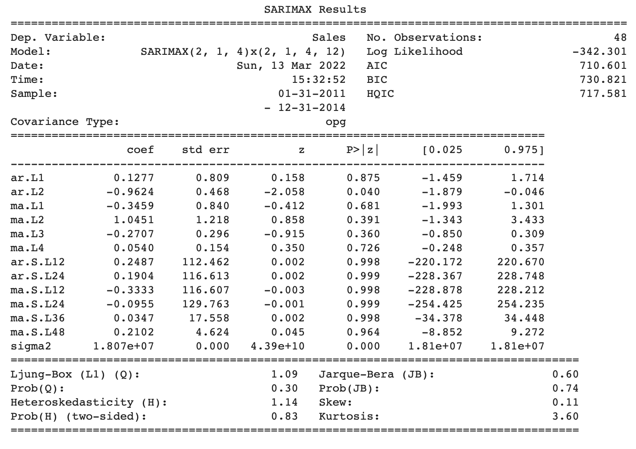
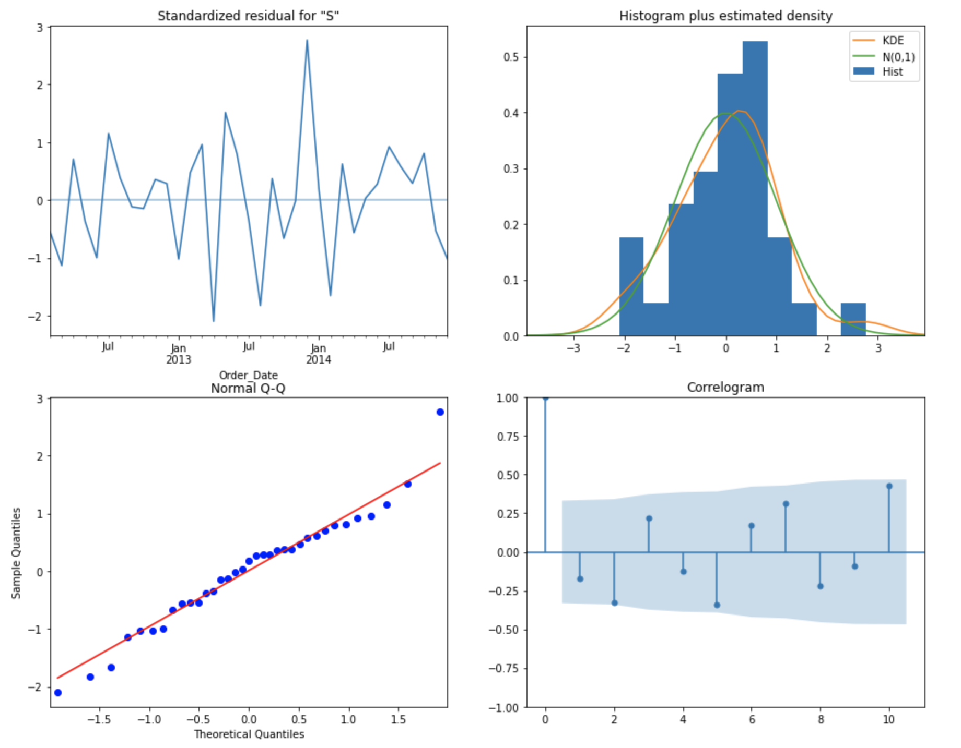
SARIMAX Evaluation

Slide 15
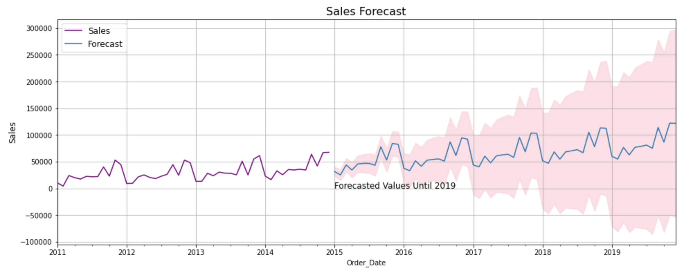
Forecasting with SARIMAX

Slide 16
ETL and Data Engineering
Using PySpark
Load data from local file system to Hadoop Cluster using Hive Table
Using Spark Session, load the data from Hive table to the Spark DataFrame
Null Value Identification and Outlier Analysis and treatment of both using Spark
Data Profiling using Spark
Execute SQL Commands using Spark
Save the data in parquet form for later use, using Spark

Slide 17
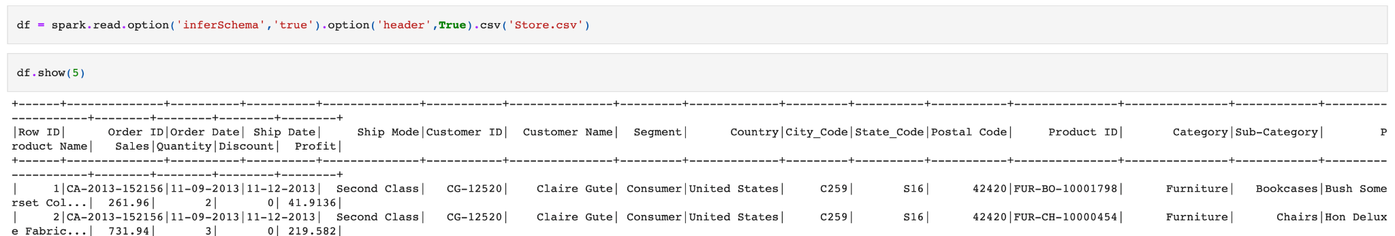
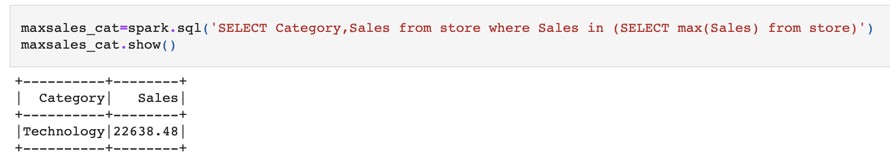
PySpark

Slide 18
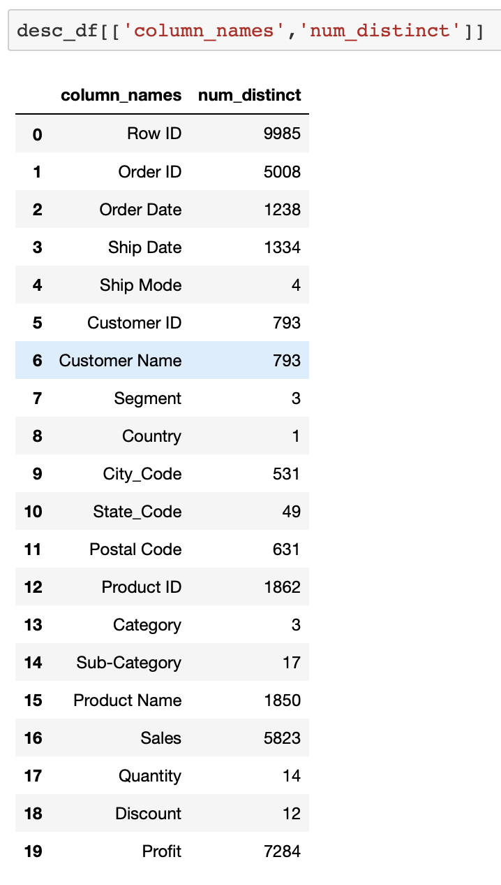
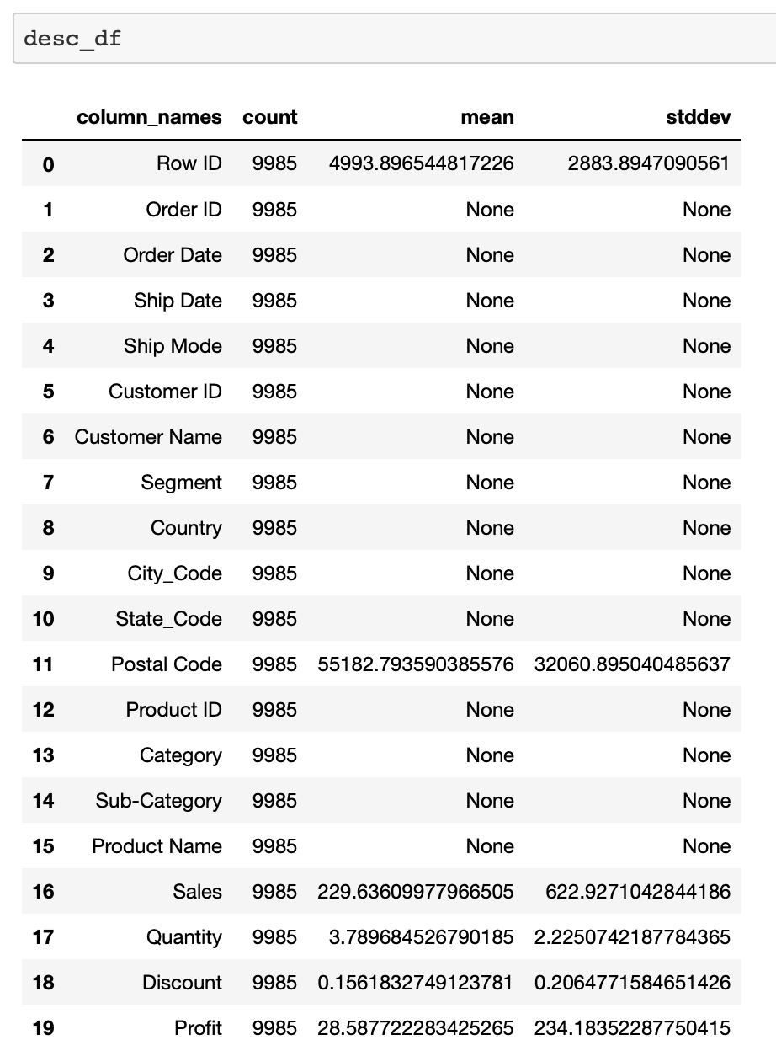
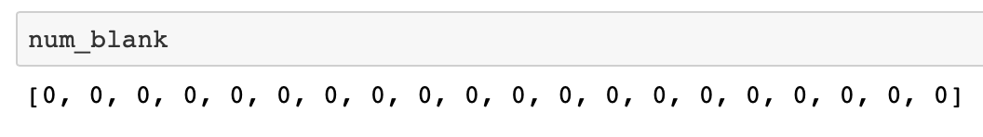
PySpark
Number of distinct values in each column
PySpark Describe Function
Number of rows containing white spaces or blanks

Slide 19
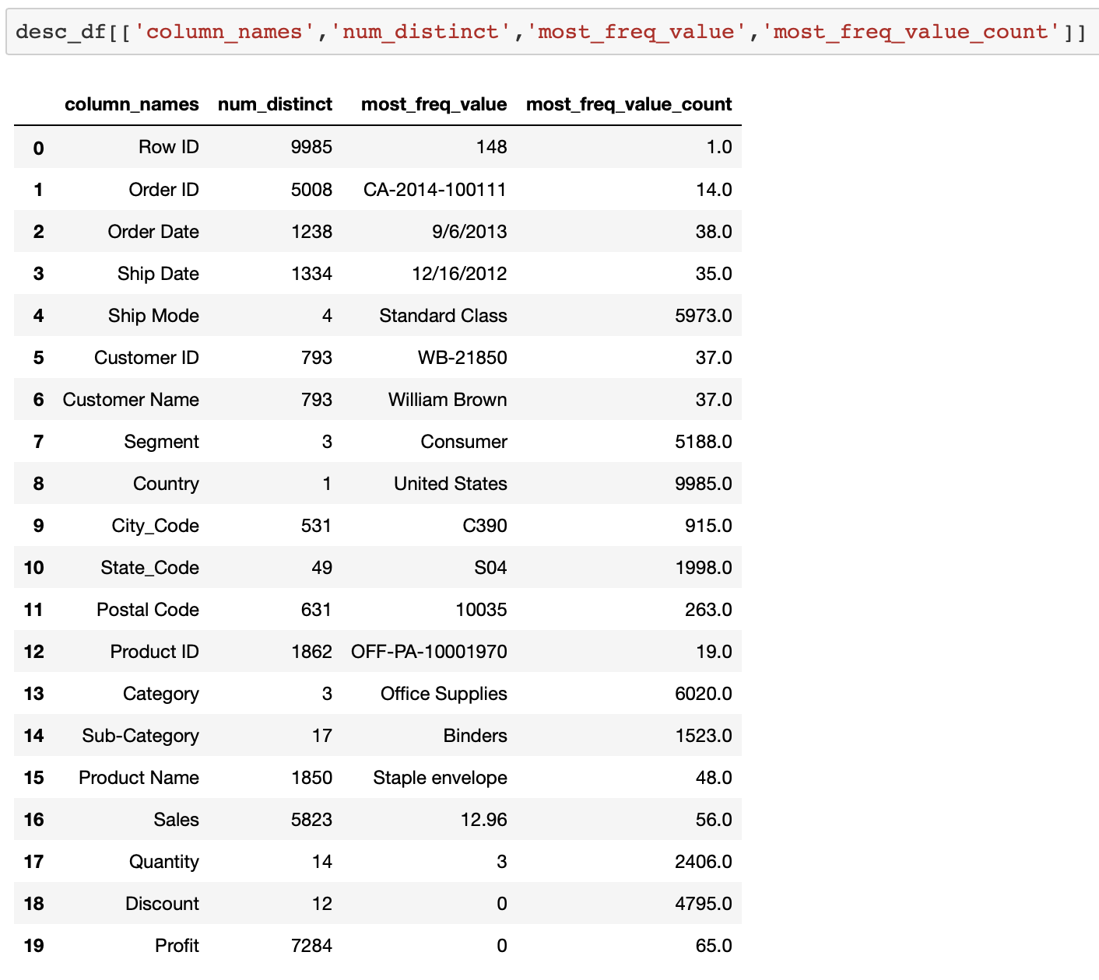
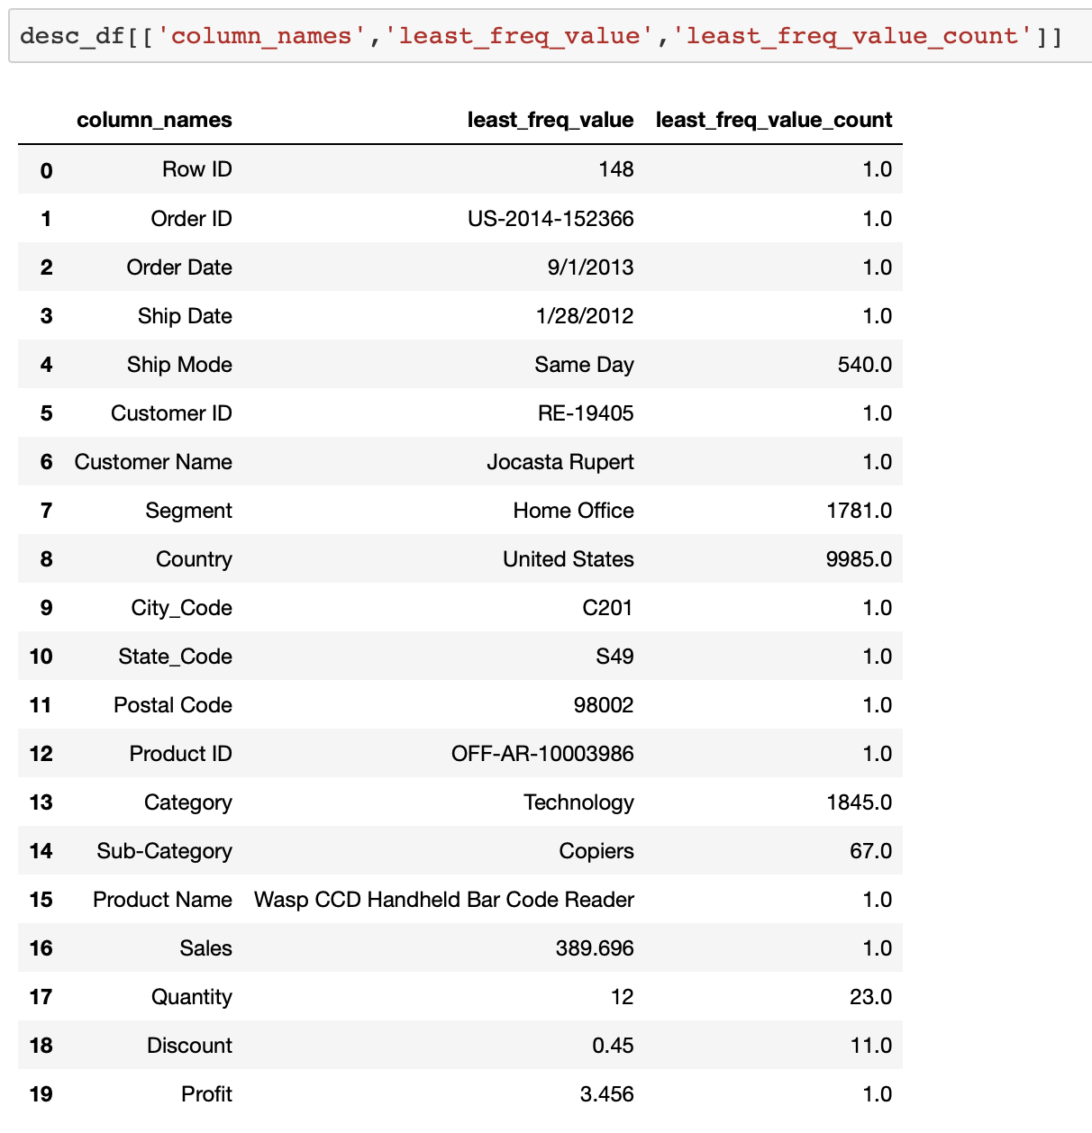
PySpark
Most frequently occuring value in a column and its count
Least frequently occuring value in a column and its count

Slide 20





AWS Cloud Analysis
Redshift
Moving the datasets to AWS S3
Creating Redshift Instance
Creating tables in Redshift
Creating a pipeline/copy command to move the data from S3(storage) to Redshift Table
Connecting Redshift data to PowerBI
Visualization in PowerBI
CSV Files
S3 Bucket
Power BI Dashboard
Power BI

Slide 21
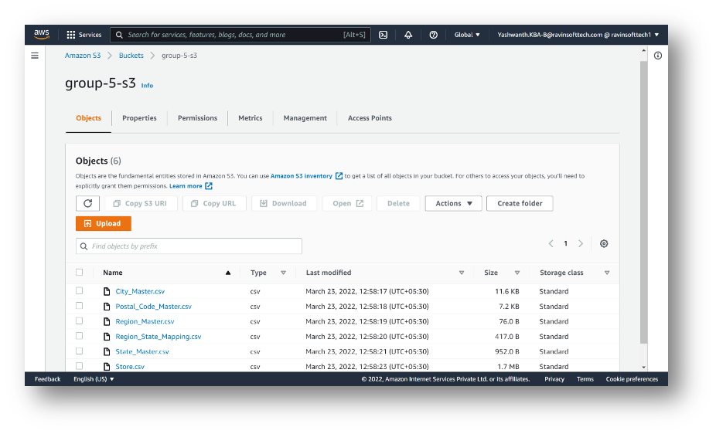
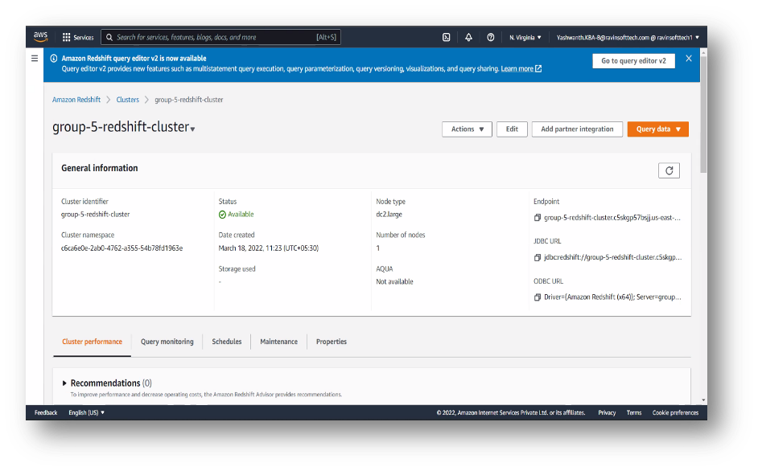
AWS Cloud Analysis
We made an AWS S3 Bucket and moved all the datasets into the same and we also created a Redshift Instance.

Slide 22
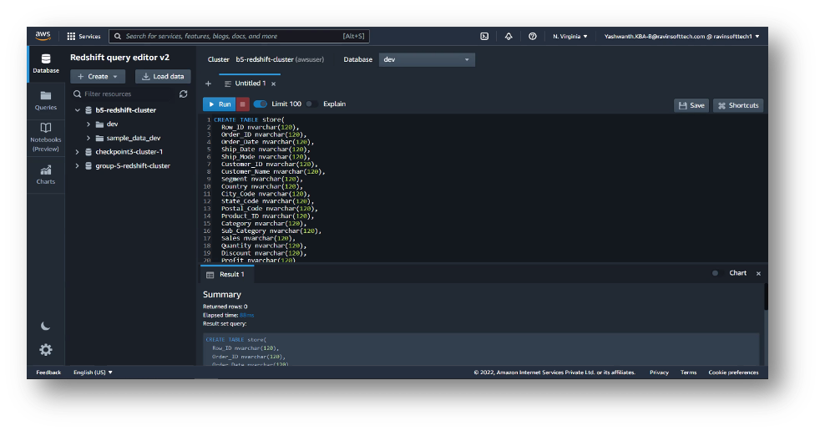
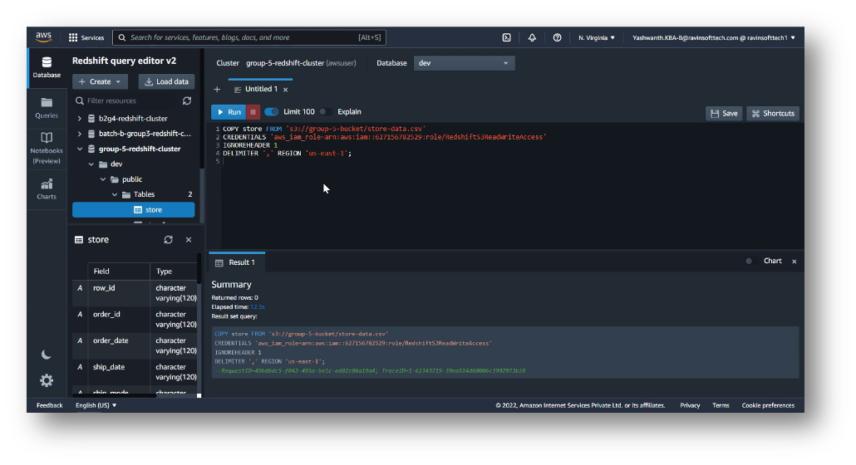
AWS Cloud Analysis
We then made tables in Redshift and moved the data from S3 into the created tables using COPY command.

Slide 23
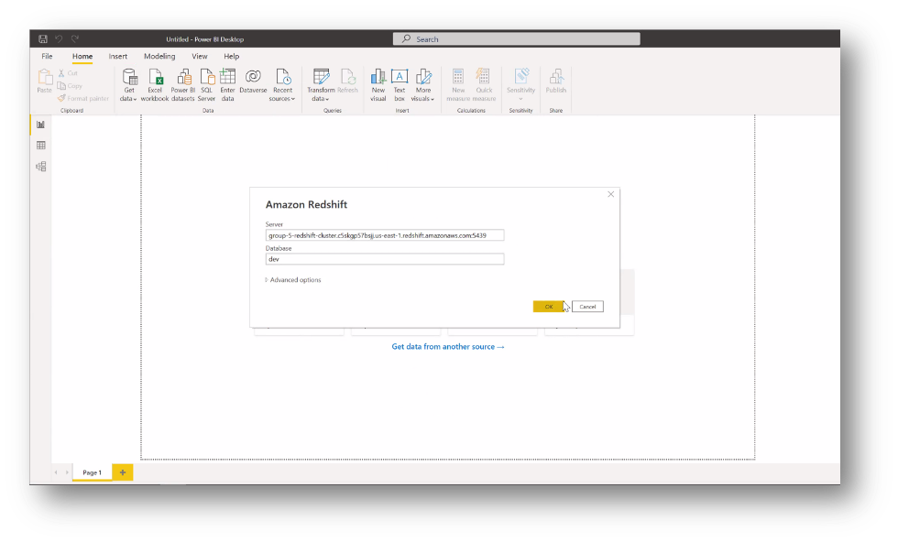
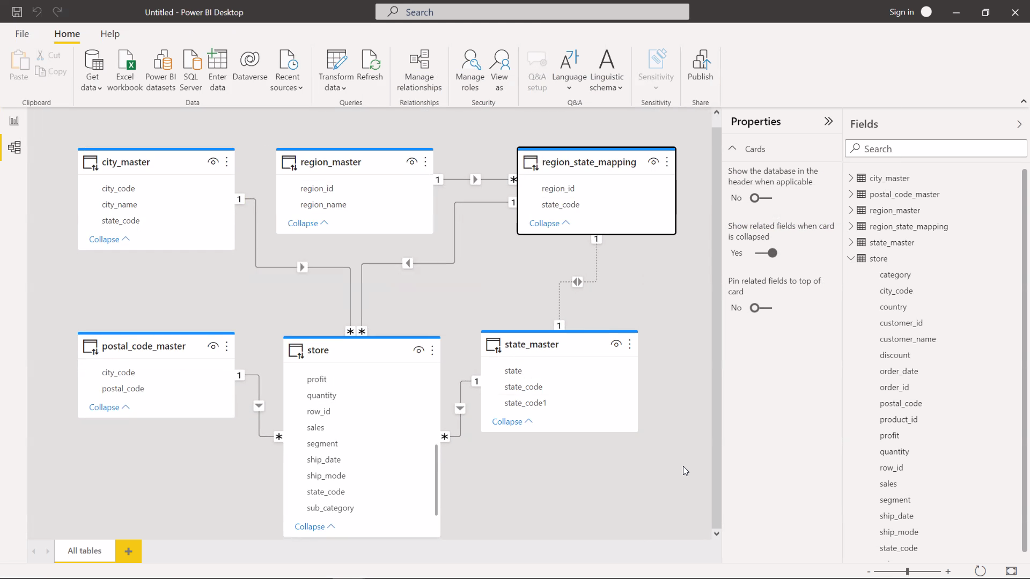
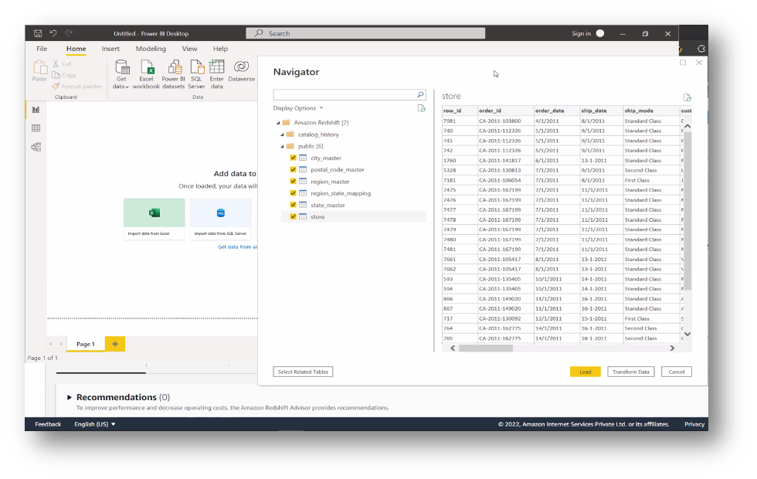
AWS Cloud Analysis
We then connected Redshift to PowerBI and checked the relationship between all the tables created

Slide 24
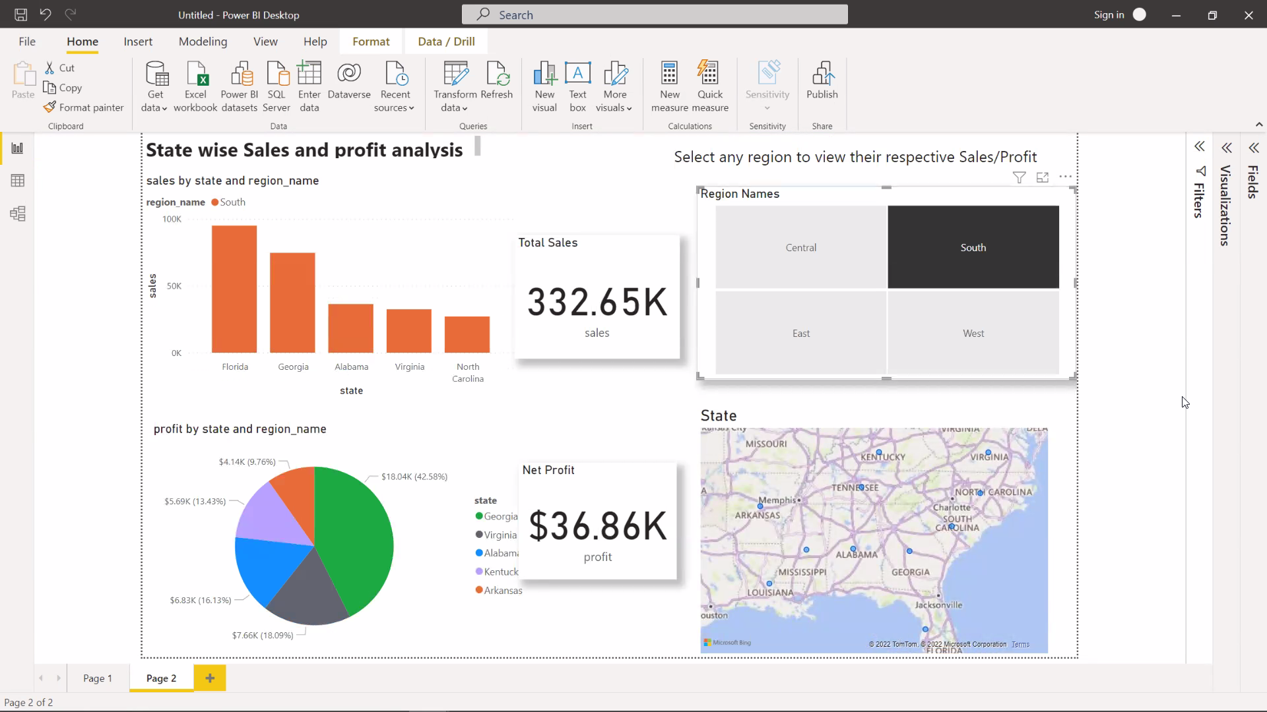

AWS Cloud Analysis
Power BI Dashboard

Slide 25

ML Model Deployment
Using Flask Architecture
ML Model
PKL File
Number of Months to Forecast Sales For.
Front End
Forecasting Sales
Flask
App.py
Used for Prediction
Generated PKL File
ML Model
Forecast Graph

Slide 26

Deployment and DEMO

Slide 27
Conclusion
Data Analysis and Visualization for understanding the data
Data Pre-Processing for the model
Model Building and Comparison
Forecasting Sales for future
Working with PySpark for ETL and Data Engineering
AWS Cloud Analysis
Deploying the Model using Flask and hosting it on AWS

Slide 28

Thank You!!!

